Slide 1

SkinDocAI: AI-Based Skin Cancer Detection from Medical PDF Images Using HAM10000
Vidyavardhini’s College of Engineering and Technology
Department of Artificial Intelligence and Data Science
Presented By -
40 Shravani S. Raut
Under the guidance of
Ms. Kranti Gule
Academic Year
2026-27

Slide 2
Introduction
Skin cancer is one of the most common forms of cancer, and early identification of suspicious skin lesions can help patients seek appropriate medical evaluation at an earlier stage.
Traditional assessment of skin lesions relies heavily on visual examination and dermoscopic analysis by trained medical professionals.
However, the increasing availability of medical images has created opportunities for Artificial Intelligence (AI) and Deep Learning to assist in automated skin-lesion analysis.
SkinDocAI is an AI-based skin cancer detection system developed using the HAM10000 (Human Against Machine with 10000 training images) dataset. The system focuses on binary classification of skin-lesion images into Benign and Potentially Malignant categories.
Benign = Non-cancerous
Potentially Malignant = Possibly cancerous

Slide 3
Problem Statement and Objective
Problem Statement
Manual examination of skin infection requires medical expertise and can be difficult to perform consistently when large numbers of images need to be assessed. Furthermore, skin-lesion images may be embedded inside medical reports or PDF documents rather than being available as individual image files.
Therefore, there is a need for an AI-based system that can automatically extract skin-cancer images from PDF documents and perform preliminary classification of the lesion based on its visual characteristics.
Objective
The main objective of SkinDocAI is:
To develop an AI-based skin cancer detection system that extracts a skin-infection image from an uploaded PDF and classifies it as Benign or Potentially Malignant using a deep learning model.

Slide 4
Literature Survey
Sr. No. | Author | Method / Dataset | Key Findings
1 | Tschandl et al., | HAM10000 Dataset | Introduced a dataset of 10,015 dermoscopic images covering seven common types of pigmented skin lesions. It provides a useful benchmark for developing AI-based skin-lesion classification systems.
2 | Esteva et al., | Deep Convolutional Neural Network | Demonstrated that deep learning can classify skin-cancer images and achieve performance comparable to trained dermatologists in specific experimental settings.
3 | Haenssle et al., | CNN-based melanoma classification | Compared a deep-learning system with dermatologists for melanoma recognition and showed the potential of CNNs for automated skin-lesion assessment.
Research Gap -
Most existing systems focus on directly uploading or analyzing individual skin images. SkinDocAI extends this workflow by accepting a PDF document, automatically extracting the embedded skin image, and then performing AI-based classification. This combines PDF processing, image processing, and deep learning into a single application.

Slide 5
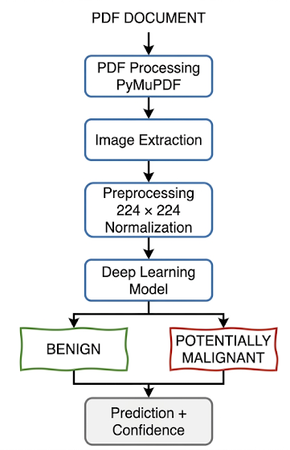
Proposed system
The proposed SkinDocAI system consists of five major components:
1. PDF Upload - The user uploads a PDF containing a skin-lesion image.
2. Image Extraction - PyMuPDF scans the PDF and extracts the embedded skin image.
3. Image Preprocessing - The extracted image is resized to 224 × 224 pixels and normalized to the range 0–1
4. Deep Learning Classification - The preprocessed image is passed to the trained model.keras model.
The model produces a prediction score.
Prediction < 0.5 -> Benign
Prediction ≥ 0.5 -> Potentially Malignant
5. Result Display - Extracted image, Prediction, Confidence score, Model information, Medical disclaimer

Slide 6
Methodology used
Step 1: Dataset Collection - The HAM10000 dataset was used for training and evaluation. For the current implementation, 1,200 images were available and successfully matched with the metadata.
Step 2: Data Preparation - The metadata was linked with the corresponding image files using the image_id.
The resulting dataset contained: 1,200 matched records.
Step 3: Binary Classification
The original diagnostic categories were converted into two classes:
0 → Benign
1 → Malignant
Here, we focus on skin cancer detection through binary classification.
Category | Count
Benign | 964
Malignant | 236
Total | 1,200

Slide 7
Methodology used
Step 4: Image Preprocessing - Each image is resized to: 224 × 224 pixels Pixel values are normalized:Original: 0–255 This makes the images suitable for deep-learning inference.
Step 5: Dataset Split
The available images were divided into:
Training: 960 images
Validation: 240 images
Step 6: Model Training - A deep-learning image-classification model was trained using the prepared HAM10000 images.
During training, the model reached very high performance on the current validation split.
Step 7: PDF Processing - The user uploads a PDF through the Streamlit application.
PyMuPDF is used to:
Open the PDF.
Scan its pages.
Identify embedded images.
Extract the image.
Convert it into RGB format.

Slide 8
Methodology used
Step 8: Prediction - The extracted image is resized and normalized before being passed to the trained model.
Example: Prediction = 0.7105
Since: 0.7105 ≥ 0.5
the system produces: Potentially Malignant
with a displayed model confidence of: 71.05%
Step 9: Result Visualization
The final Streamlit interface displays the extracted image and AI analysis.

Slide 9
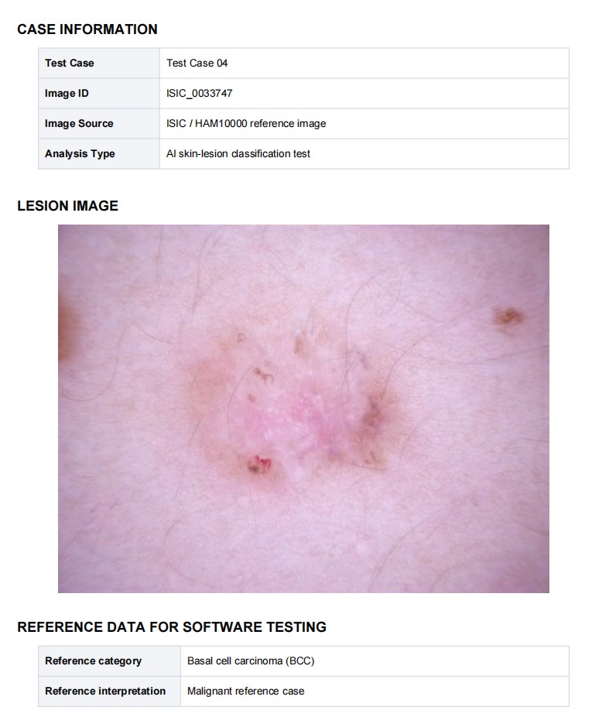
Results
Sample PDF Test Report
The system automatically extracts a skin-lesion image from a PDF document and performs AI-based skin cancer classification on the extracted image.

Slide 10
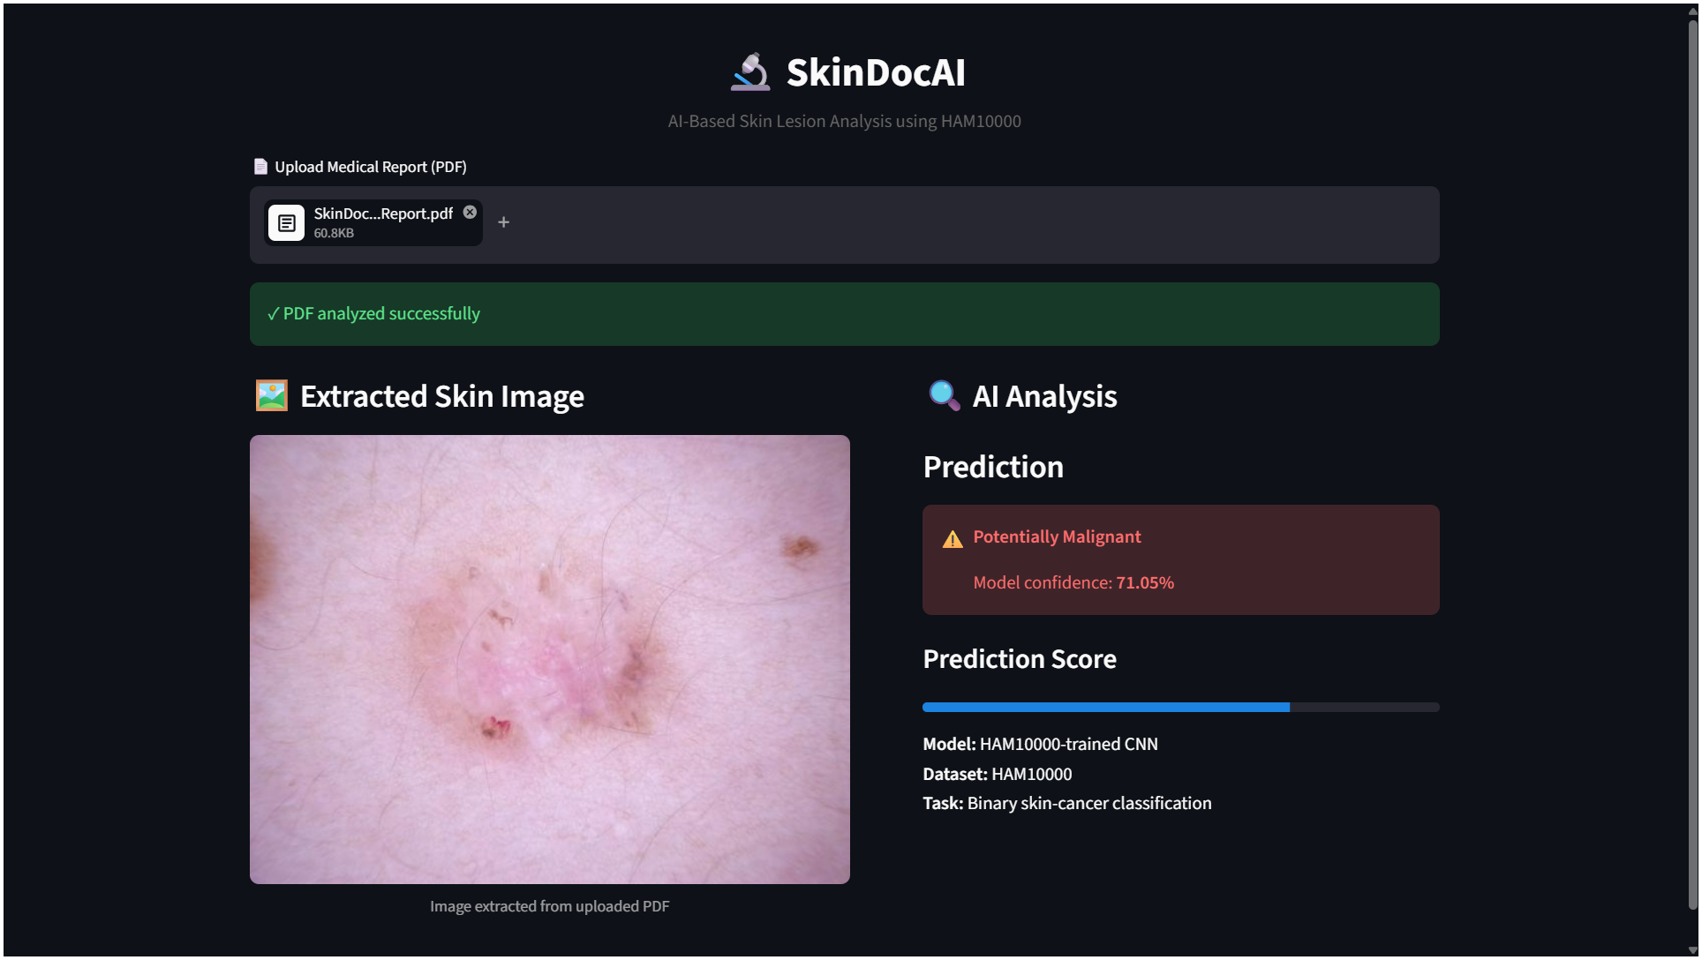
Results

Slide 11
Conclusions
SkinDocAI demonstrates an AI-based approach for skin cancer detection from skin-lesion images embedded within PDF documents.
The system integrates PDF image extraction, image preprocessing, deep learning-based classification, and a Streamlit web interface into a single workflow.
Using the HAM10000 dataset, the system was developed to classify skin-lesion images into Benign and Potentially Malignant categories.
The current implementation successfully processes uploaded PDFs, extracts lesion images, performs model inference, and presents the prediction with a confidence score.
The system is intended for educational and research purposes only and should not be used as a substitute for professional medical diagnosis.

